Slide 1


Module 1
Master of Computer Applications /
Master of Science in Information Technology
Master of Computer Applications
Subject code – Subject name
Subject code 18MCAE3052 – Subject name FUNDAMENTALS OF BIG DATA
Module 4
Title of the module
Title of the module PIG

Slide 2

UNIT IV PIG MODULE 1
DR LAKSHMI J V N
ASSOCIATE PROFESSOR
JAIN UNIVERSITY

Slide 6
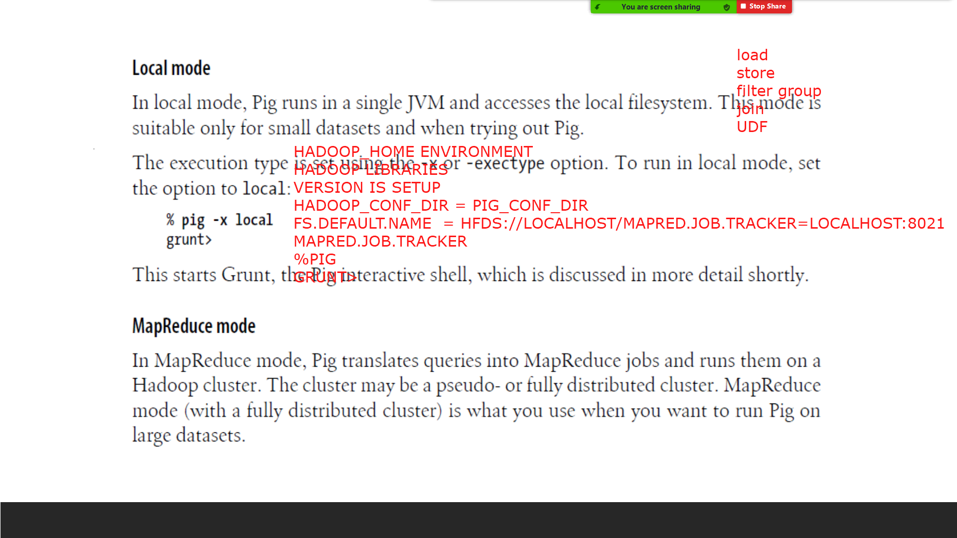

Slide 11
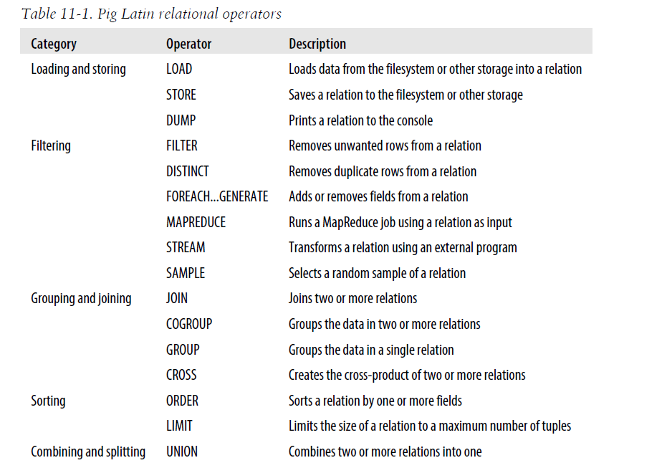

Slide 21
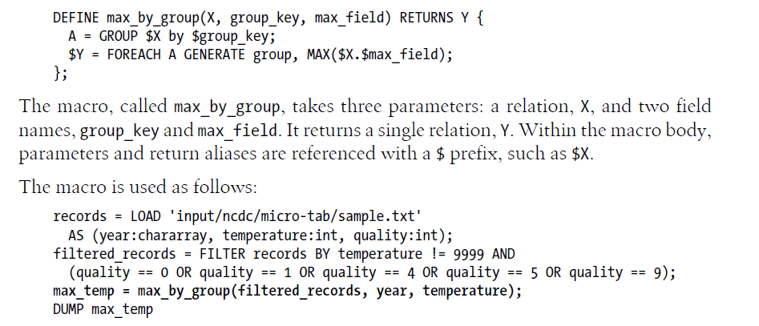

Slide 24
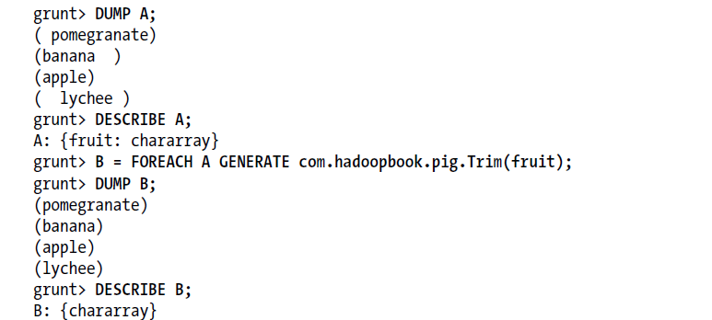

Slide 26
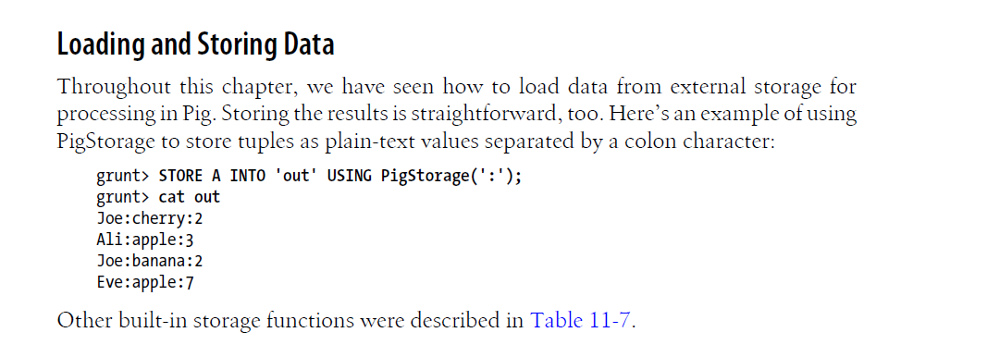

Slide 27
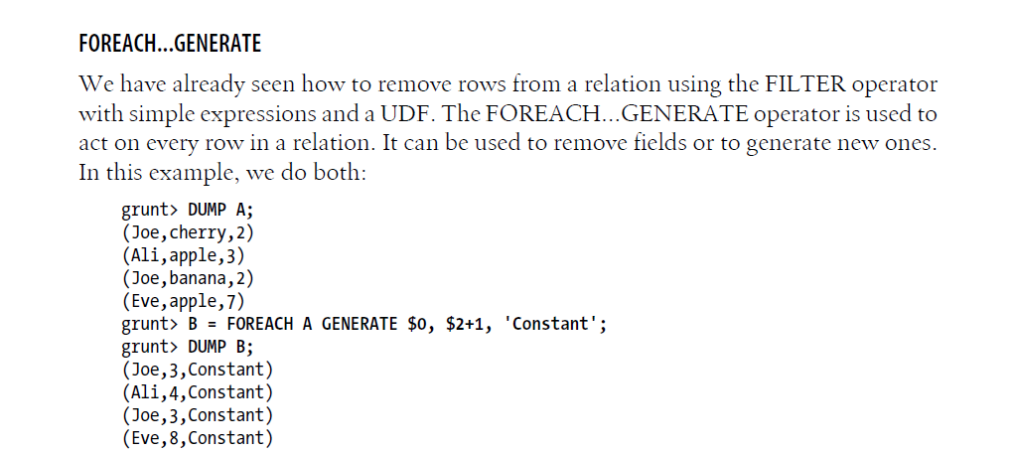

Slide 32
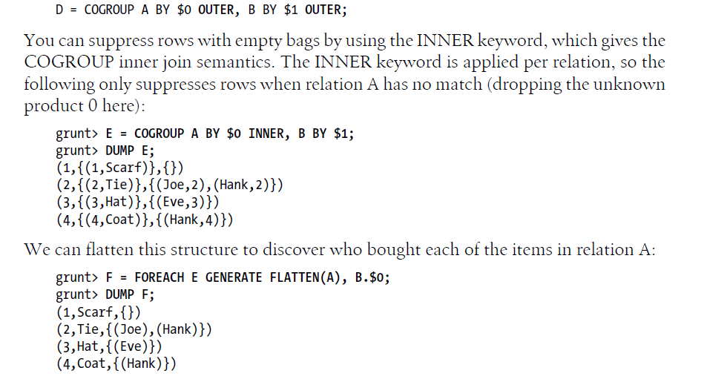

Slide 35
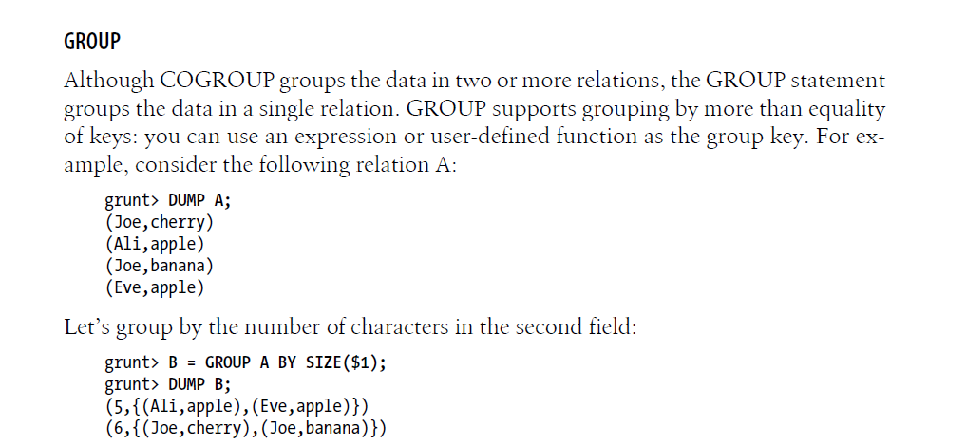

Slide 37
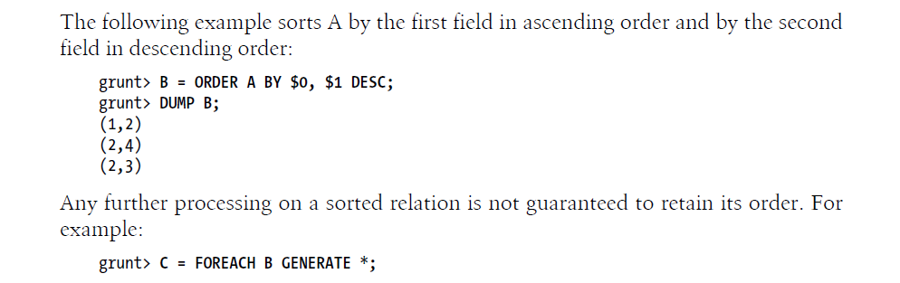

Slide 38
